Slide 1
Fetal Ultrasound Image Segmentation for Measuring Biometric Parameters Using Multi-Task Deep Learning
111032003 黃建傑

Slide 2
Introduction
在胎兒診斷中，超音波是很普遍的檢查方式，有五種方式來觀察胎兒參數 :
腹圍(abdominal circumference)
雙頂徑(biparietal diameter)
肱股長(humerus length)
頭臀長(crown-rump length)
頭圍(Head circumference,HC)
這篇主要估計HC，來判斷胎兒大小、有無異常及計算孕齡。

Slide 3
超音波的優缺點： (比起電腦斷層掃描CT和核磁共振成像MRI)
超音波的優點：
1.非入侵性、便宜、可攜帶、廣佈
2.它能幫助分析身體內部器官的疼痛、腫瘤、感染。

Slide 4
超音波的優缺點： (比起電腦斷層掃描CT和核磁共振成像MRI)
超音波缺點:
1. motion blurring (模糊 )
2. 遺失輪廓邊界
3. 有些組織聲音無法穿過的acoustic shadows (聲影)
4. 雜點
5. 低的signal-to-noise ratio
醫學上主要以有經驗豐富的超音波師來判斷及操作

Slide 5
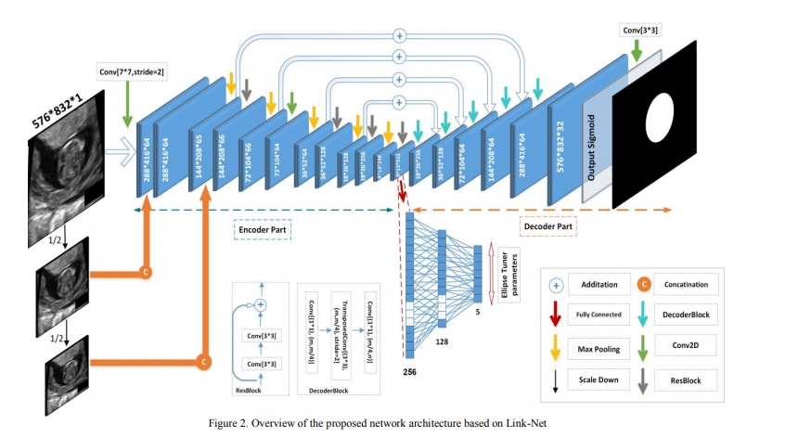
Multi-Task

Slide 6
Proposed method
Fig. 2 illustrates a block diagram of the proposed system, including two main modules:
A segmentation network and an Ellipse Tuner.

Slide 7
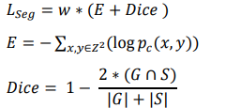

Segmentation network
Cross-entropy
Dice metric
Weighting map

Slide 8


Ellipse Tuner
Locus
Tangential Circle

Slide 9
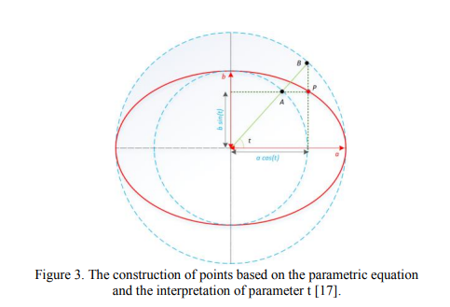

Slide 10
A.Dataset
999 two-dimensional ultrasound images of HC
The size of ultrasound images is (800,540)
Scale of pixel sizes is in the range 0.052 mm to 0.326 mm.

Slide 11
B.Augmentation
Each image by horizontal and vertical flipping, as well as using fixed rotations from -60 to 60 in steps of 20 degrees.
Remove the corrupted images from the training set and keep images with a complete fetal head.
Generated 8823 augmented US images in total.
(75%, 25%) for training and test.
10% of the training set as validation data.

Slide 12
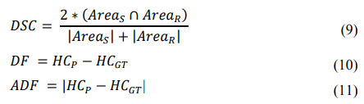

Evaluation
Dice Similarity Coefficient
Difference
Absolute Difference
Hausdorff Distance

Slide 13
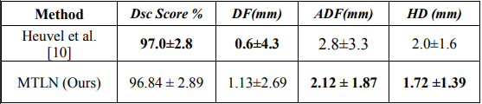
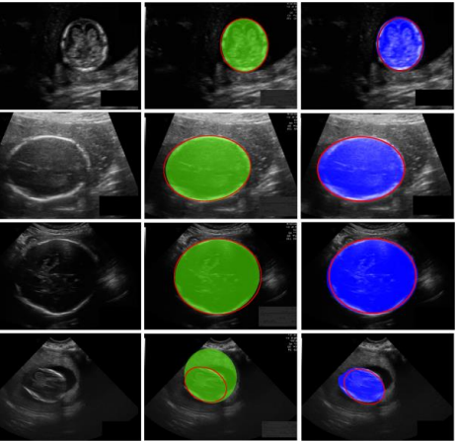
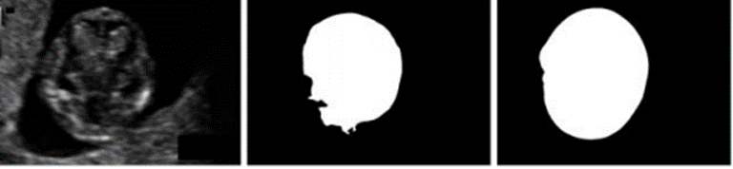
Table 1. Segmentation of fetal head
Figure 1. Comparison of segmentation results
Figure 2. Comparison of segmentation results

Slide 14
Conclusion
The proposed system incorporated an Ellipse Tuner based on fully connected networks. We demonstrated that the performance of a multitask network is better than the single-task network with no Ellipse Tuner and leads to smoother and cleaner elliptical segmentation results.

